Slide 1
WISE
Worcester Institute for Senior Education
assumptionwise.org
wise@assumption.edu

Slide 2
BE WISE AND JOIN
Become a member and engage in a friendly active community of lifelong learners.

Slide 3
WISE
Our Mission
To promote lifelong learning opportunities by offering:
courses in a variety of topics
special interest groups for in-depth discussions
activities to foster social engagement and a sense of community

Slide 4
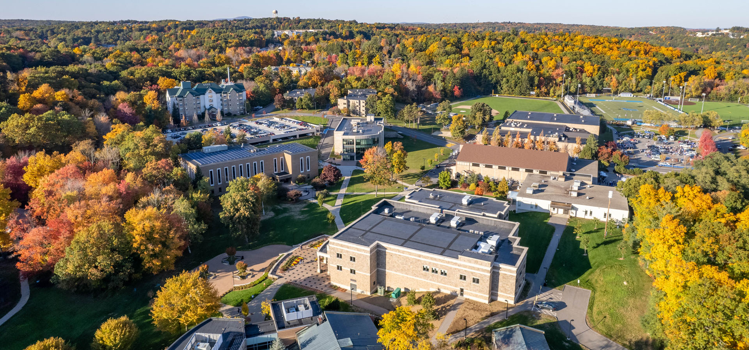
Our History
April 1992: 7 retired social workers created the Worcester Area Institute for Learning in Retirement
November 1992: Impressive growth gains WAILIR instant credibility
February 1993: The Worcester Institute for Senior Education becomes an affiliate organization of the School of Graduate and Professional Studies at Assumption University in Worcester, MA.
Members can enjoy performances and sports events on campus at no cost.

Slide 5
MEMBERSHIP for 2023-2024
A WISE membership provides adult learners with unlimited access to a compelling selection of courses. Choices are available for both online and in-person instruction.
Full-Year Membership $340 All Sessions A, B, C, and D
Half-Year Membership $175 Sessions A & B or C & D

Slide 6
Courses
Year-Round Courses in a Variety of Topics
With a membership, you can enjoy:
Up to 15 Courses Per Session
Each Course Consists of 5 classes
Fall A & B Sessions: September into December
Spring C & D Sessions: February into May

Slide 7
More about Courses
We offer a variety of modalities
Zoom only
In Person only
Both In Person and on Zoom
Courses usually meet once a week and do not overlap.
Missed a class? Zoom Class recordings are provided.

Slide 8
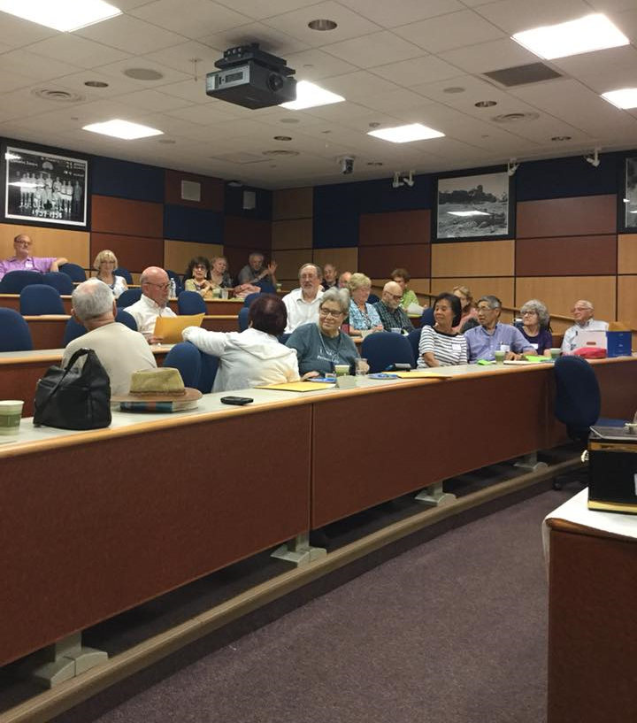
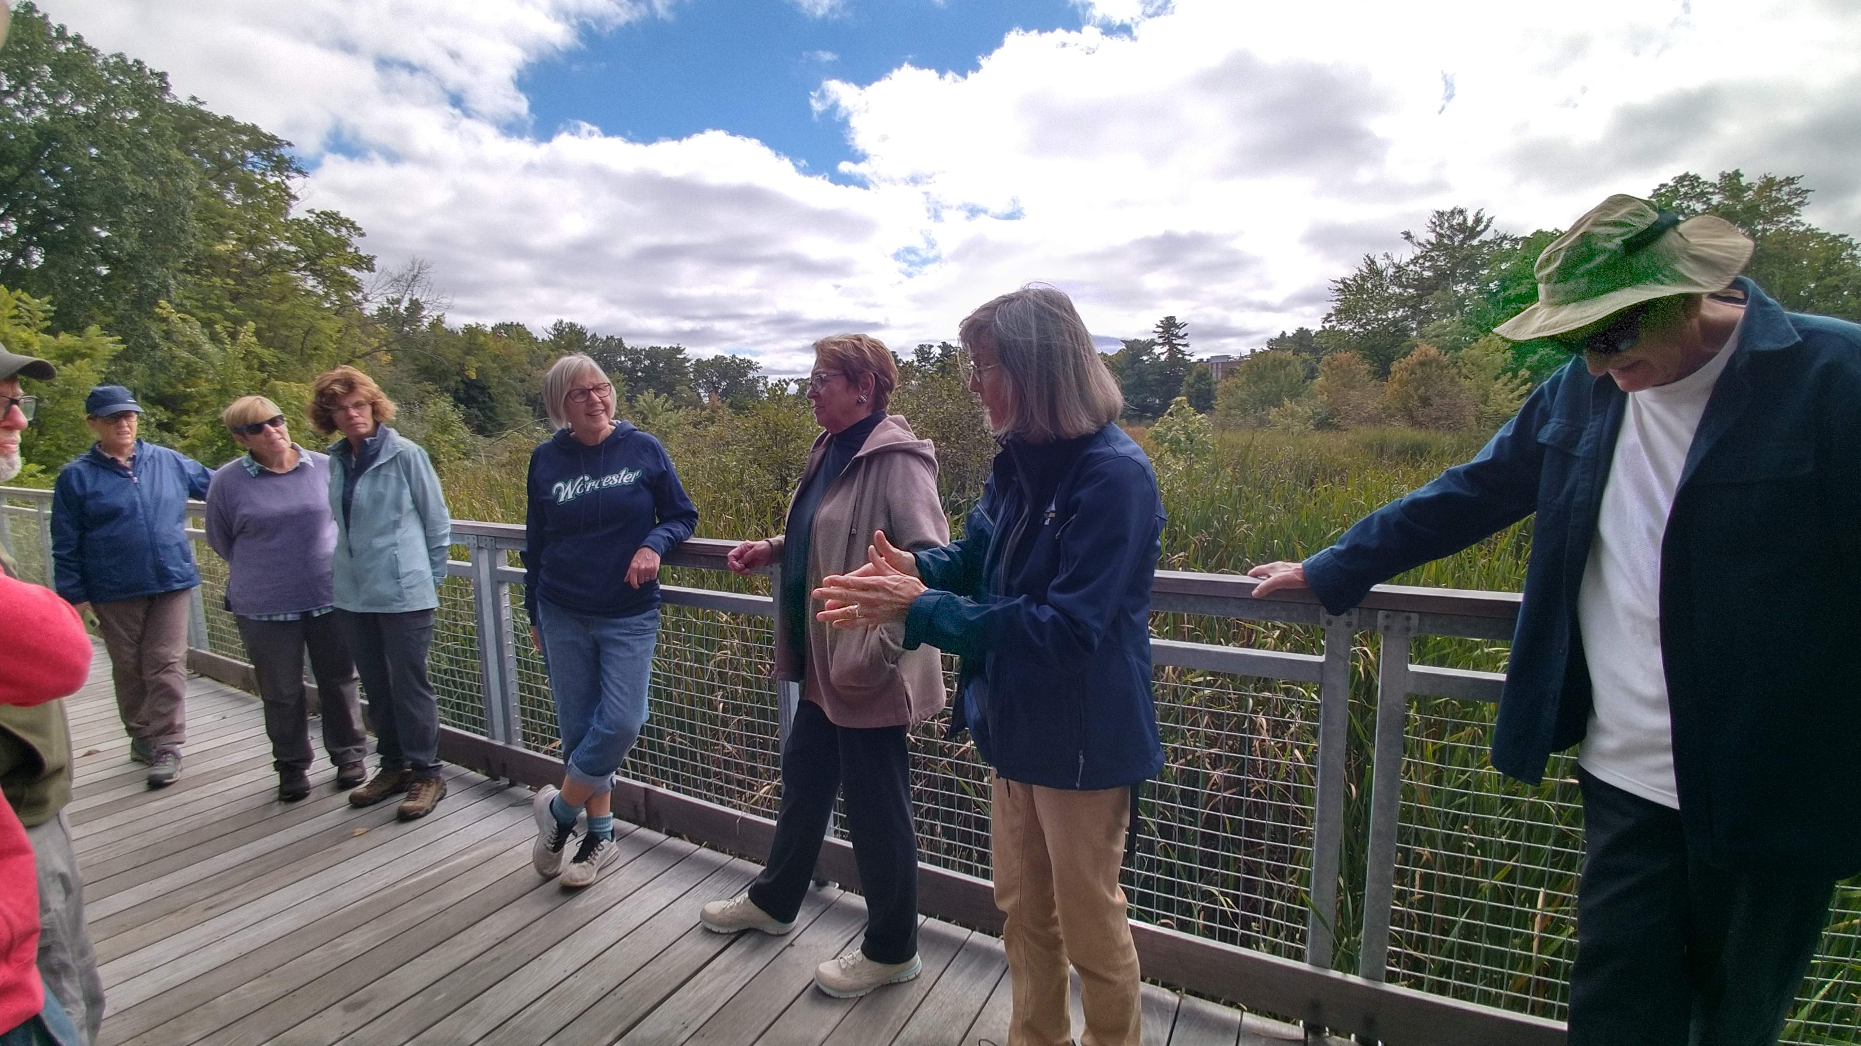
A Sample of Fall 2023 Courses
Offered in person; join us at Assumption University and other locations:
A2. Rustic Novels of George Sands A3. The Play’s the Thing
A5. Hanover Theatre tour (at Hanover Theatre)
A7. Robert Moses, NY Urban Planner (at Briarwood)
A11. How to Read Shakespeare (at The Willows)

Slide 9
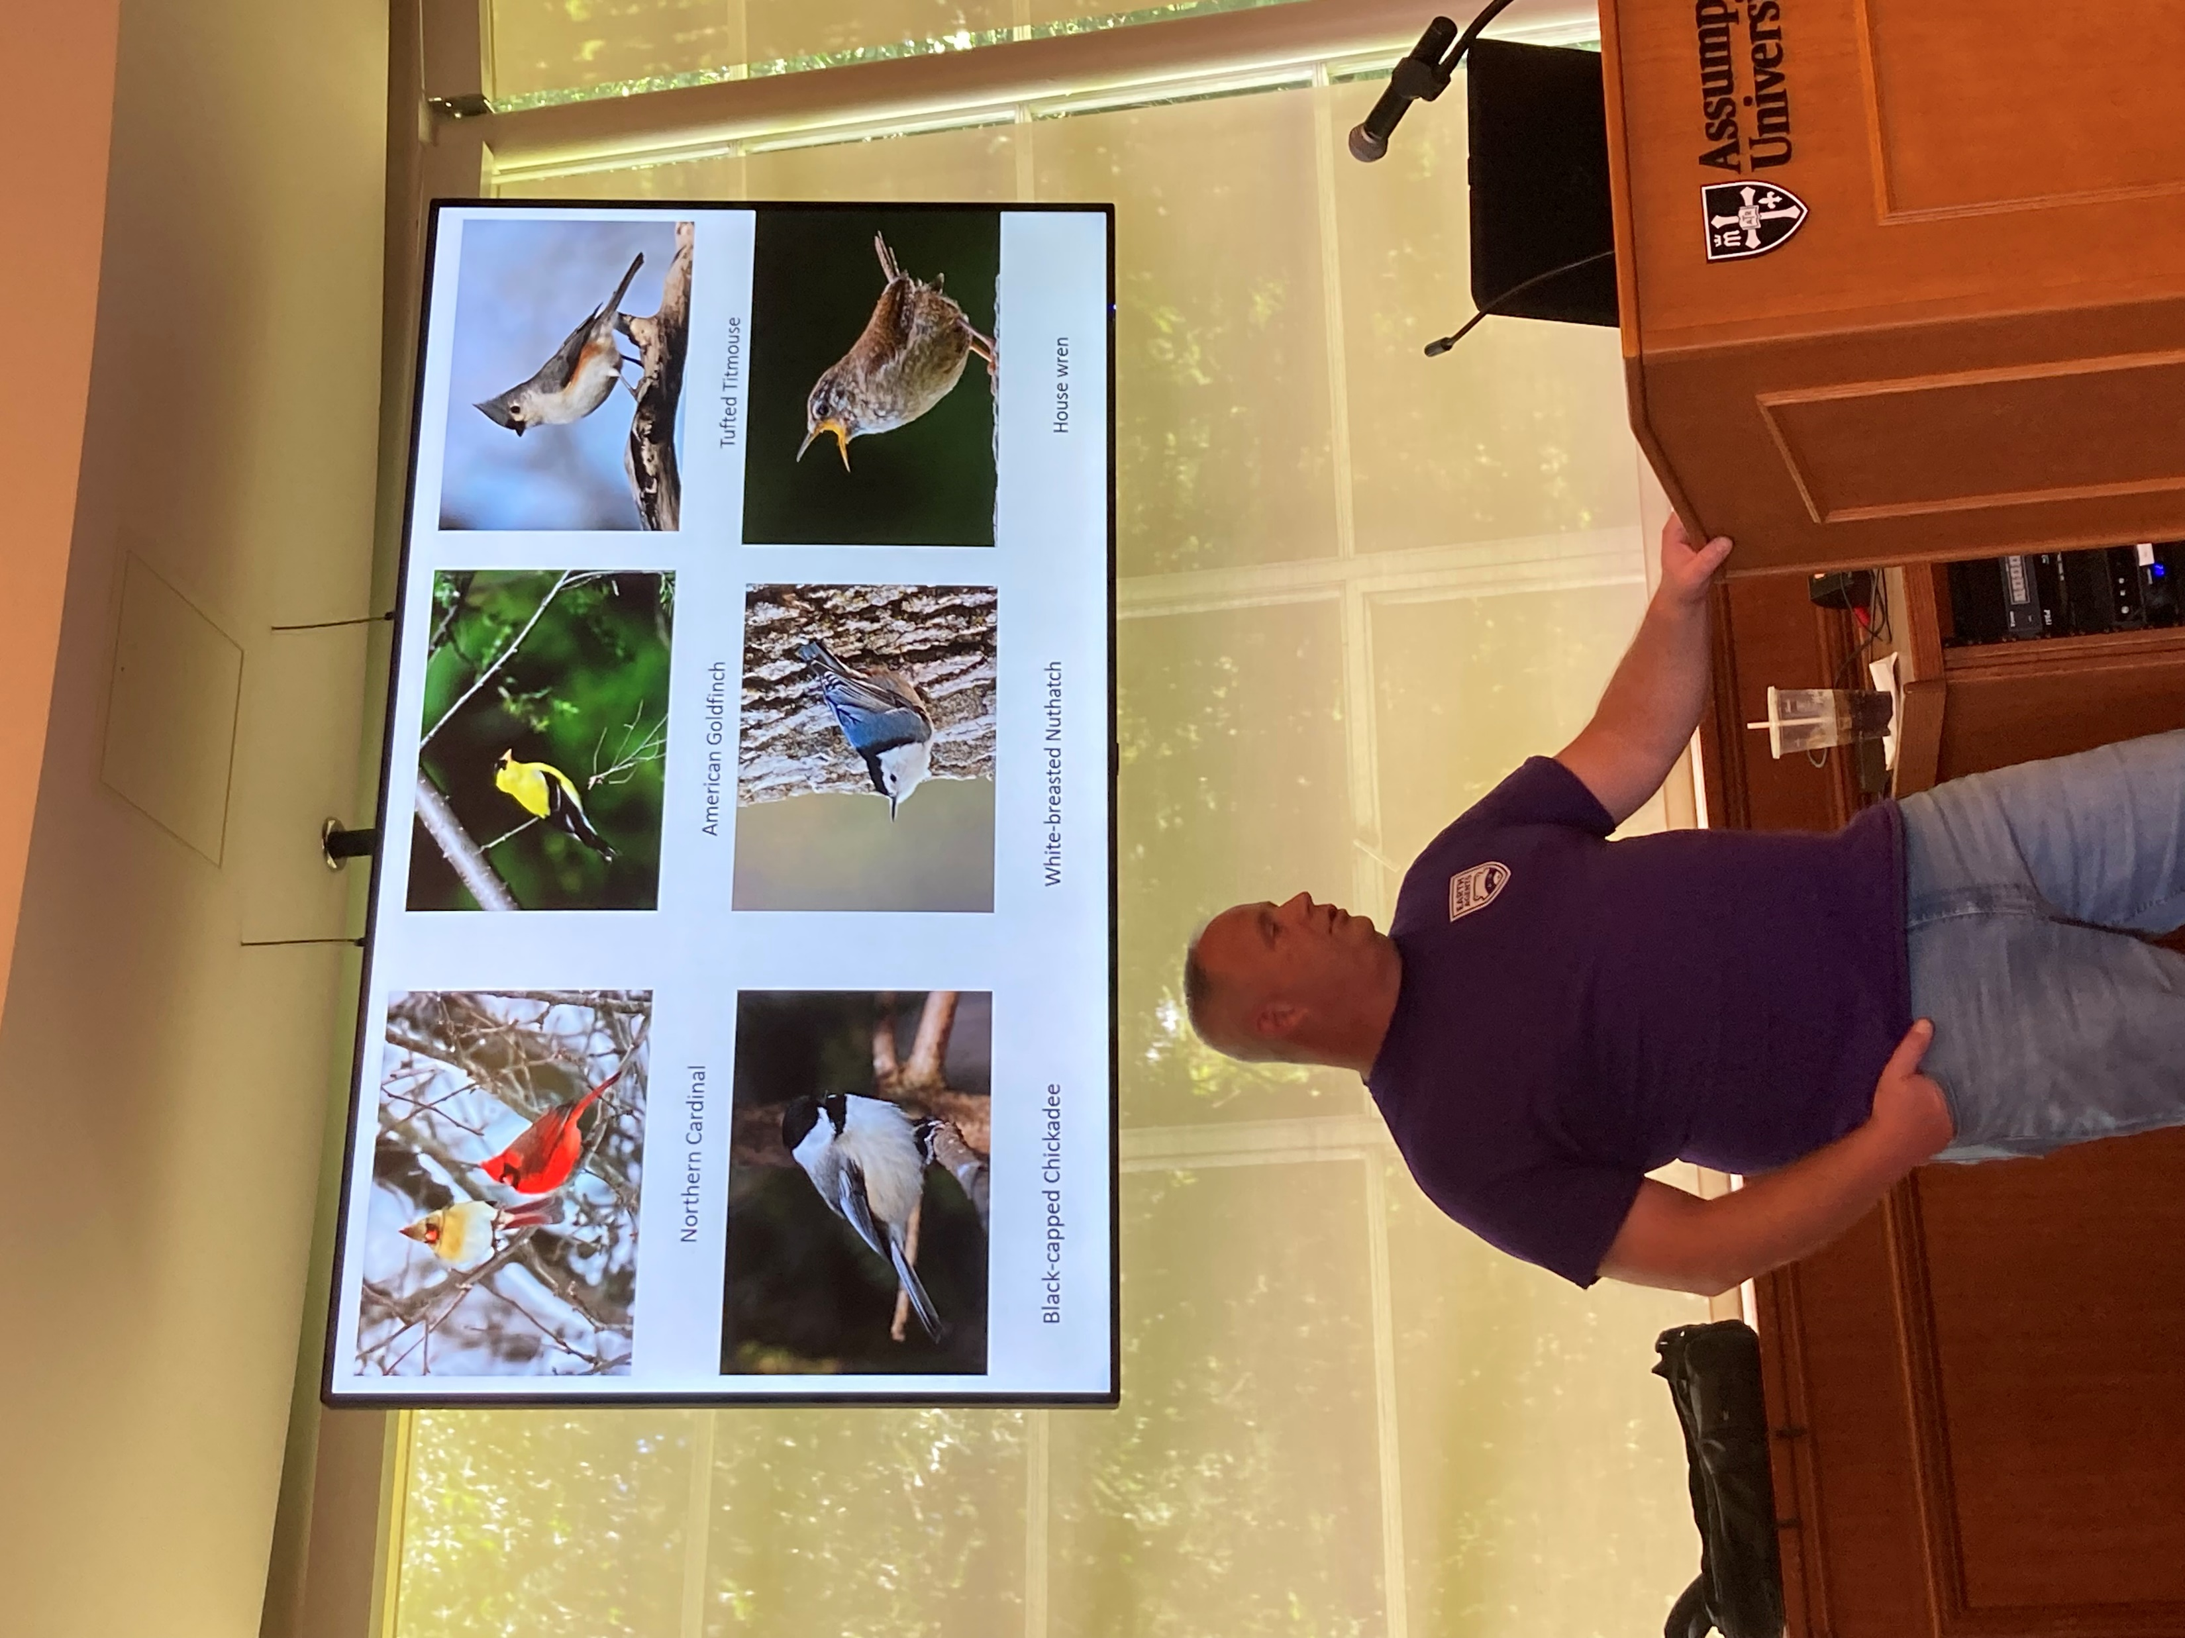
More Courses in Fall 2023
Offered on Zoom Only:
A1. Jazz History 1
A4. New England Art Museums
A10. Operation Paperclip
A13. Celtic Spirituality
A15. 24 Democracies
B1. Jazz History 2
B9. Fall Bird Behaviors
B10. Legend of Ned Ludd

Slide 10
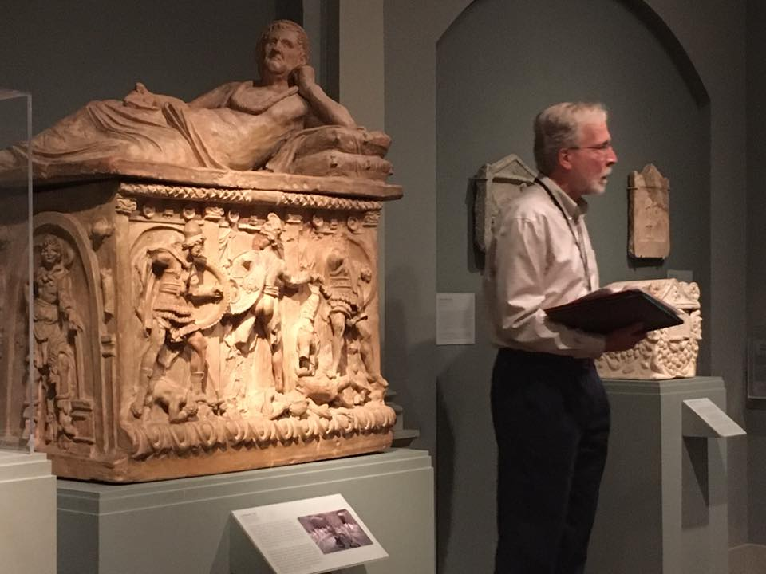
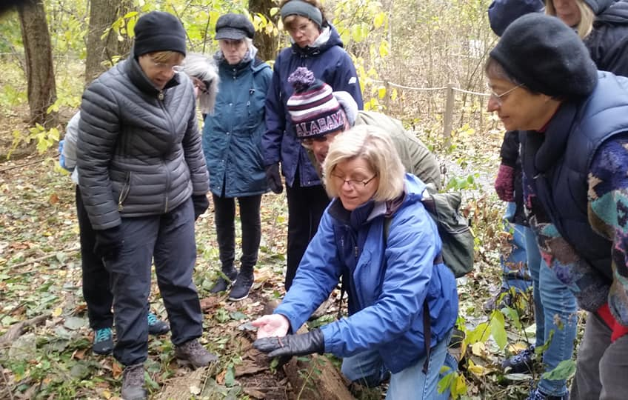
WISE INSTUCTORS
WISE has successfully grown a community of adult learners who enjoy teaching and learning.
Instructors come to WISE from every academic level:
Doctorate
Master’s
Bachelor’s
Enthusiast

Slide 11
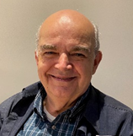
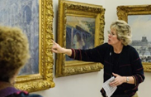
Meet Some of Our Instructors
It’s all for the fun of learning! No tests, no quizzes, no grades, no pressure!
Joe Corn, WISE President Emeritus, professional career as an engineer. Taught at Springfield Technical Community College, Penn State University, and technical instructor for Moore Products Co.
Great Female Artists and their Music
Martha Chiarchiaro master’s degree in the history of art from Williams College. Teaches classes at the Worcester Art Museum, Worcester State University, and WISE. The Art Museums of New England
and Impressionism – A Chronological Exploration
Paul Mahon, Professor Emeritus at Assumption University and a Worcester Art Museum docent and corporator.
Survey of WAM Collections

Slide 12
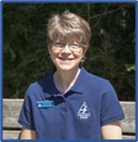
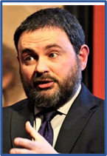
Meet Some of Our Instructors
Courses cover a broad range of subjects to meet the interests of our members.
Paul Buono, member of the music faculty at Worcester Polytechnic Institute, Clark University, and Assumption University where he is the director of the jazz ensemble.
Jazz History 1 and Jazz History 2
Marth Gach, Education Manager for Mass Audubon’s Central Region. Ecologist and evolutionary biologist. Draws connections to strengthen the relationship humans have with the environment.
Walking Worcester’s Green Spaces
Ben Railton, Professor of English and American Studies at Fitchburg State University. Author of 7 books and contributes to the bimonthly “Considering History” column in the Saturday Evening Post.
Great American Short Stories

Slide 13
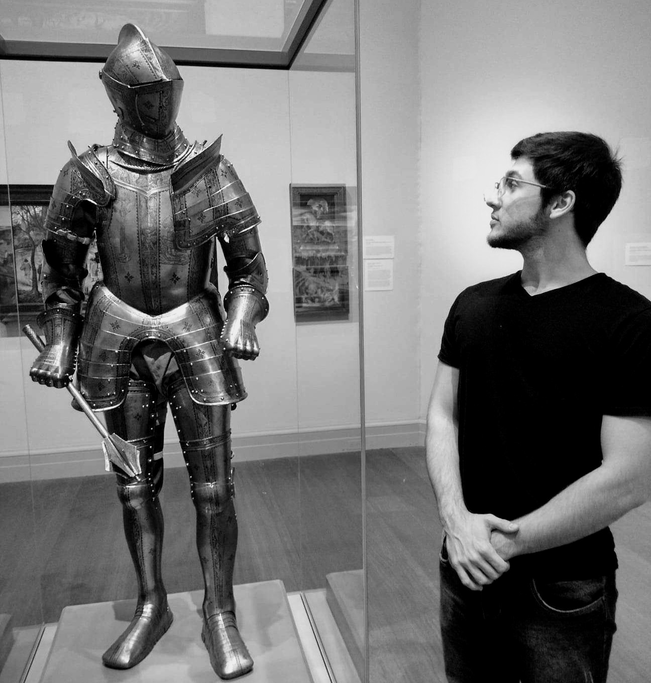
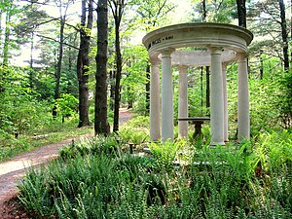
WISE Makes Its Way Around
Courses are conducted in venues in an around Worcester, MA
Assumption University
Briarwood Retirement Community
Ecotarium Science Museum
Hanover Theater
Jewish Community Center
Mass Audubon's Broad Meadow Brook Conservation Center
New England Botanic Garden at Tower Hill
The Willows Retirement Community
Worcester Art Museum
Worcester Historical Museum

Slide 14
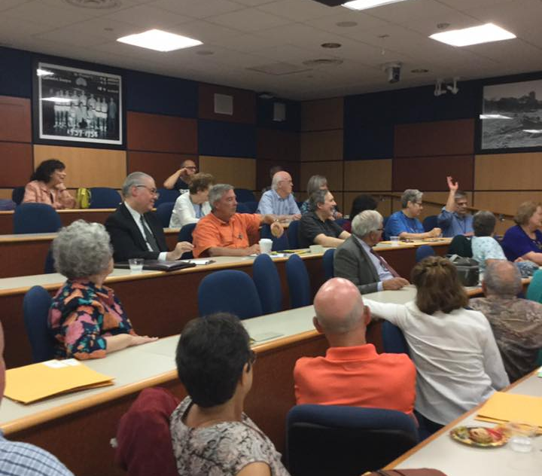
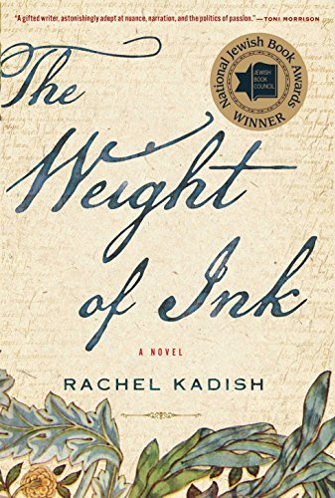
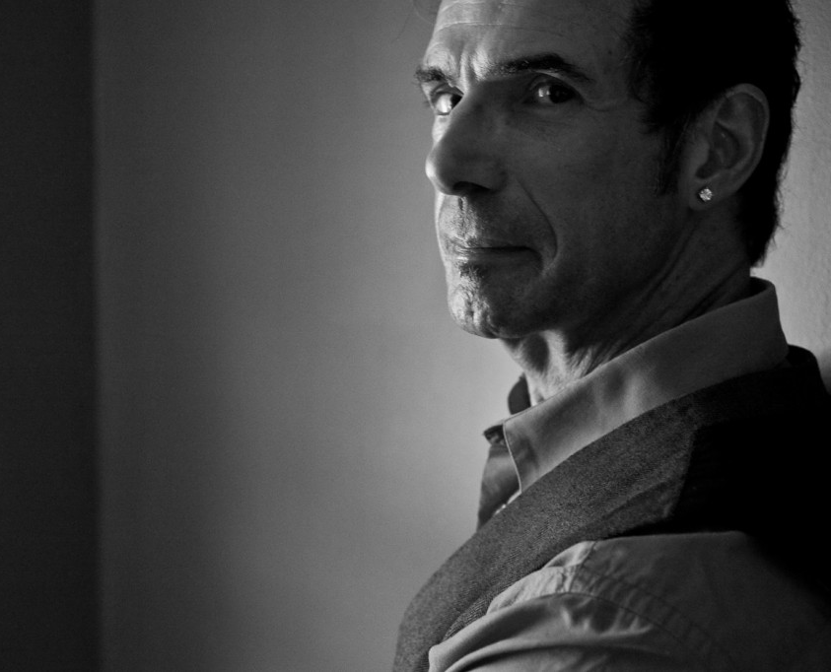
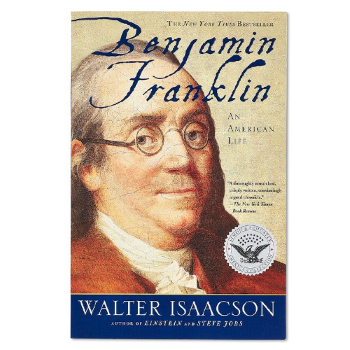
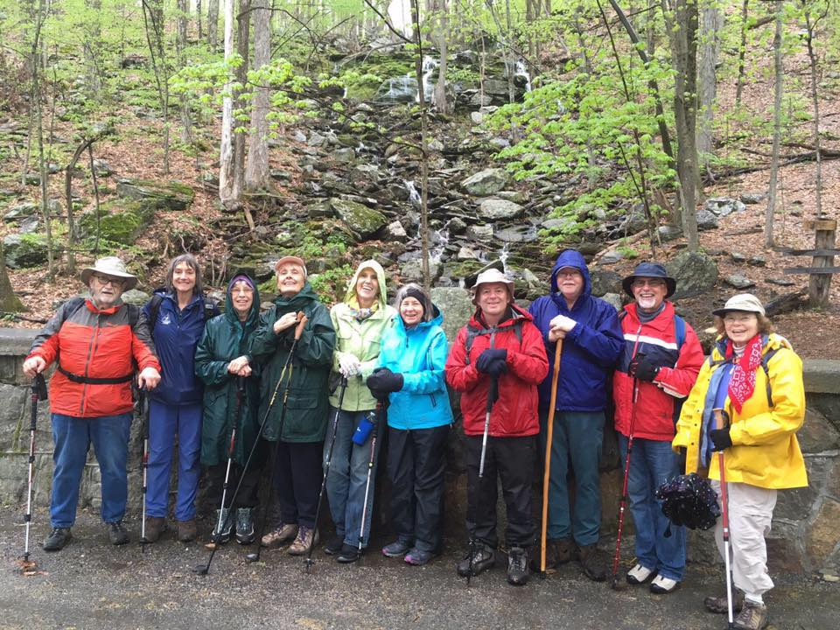
Enjoy the Benefits of Membership
Unlimited Classes Each Session
Movie Club
Fiction and Nonfiction
Book Clubs
Spotlight Lectures
Motown & the Civil Rights Movement
-Tom Ingrassia
Creative Director,
The Supremes
Special Events

Slide 15
WISE
Worcester Institute for Senior Education
Contact WISE by
Telephone at 508-767-7513
Webpage at assumptionwise.org
Email at wise@assumption.edu

