Slide 1
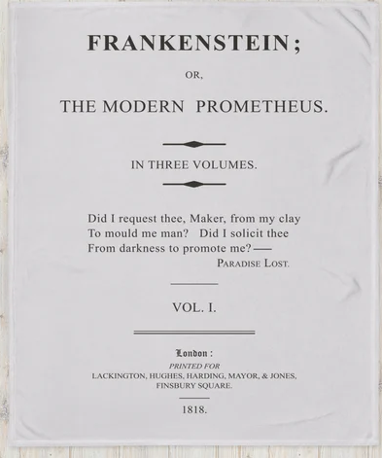
The Modern Prometheus 2.0:
The Ethics of AI
“Did I request thee, Maker, from my clay to mould me man? Did I solicit thee from darkness to promote me?”
Milton, “Paradise Lost”

Slide 2
WHAT DO THESE QUESTIONS HAVE IN COMMON?
How might we use AI for everything from lightening our workloads to solving big problems like global warming and curing cancer?
How do we prevent AI from assuming our workloads and causing massive unemployment and social inequality?
How might rogue actors use AI for misinformation, market manipulation, attacks on infrastructure, etc.?
How can we prevent AI from doing us inadvertent harm?

Slide 3
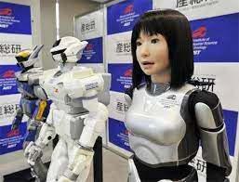
They All Treat AI As A Tool.
What If It Were A Person?
How would we know?
What would we do differently?

Slide 4
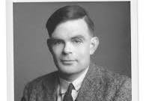
THE TURING TEST FOR ATTRIBUTING GENERAL ARTIFICIAL INTELLIGENCE:
“A test of a machine's ability to exhibit intelligent behavior equivalent to, or indistinguishable from, that of a human. Turing proposed that a human evaluator would judge natural language conversations between a human and a machine designed to generate human-like responses …If the evaluator could not reliably tell the machine from the human, the machine would be said to have passed the test.”
-- from Wikipedia, “Turing Test”
Alan Turing

Slide 5
PASSING THE TURING TEST? OR GAMING IT?
In 1966, Joseph Teitlebaum designed “ELIZA” to replicate a Rogerian psychotherapist, using a souped up version of auto-correction.
In 1972, Ken Colby created PARRY to model a paranoid schizophrenic. It was subjected to a Turing Test and fooled 52% of the psychiatrists asked to determine if it was human.
In 2022, Brad Lemoine, an AI researcher working on Large Language Learning Models at Google declared the program he was working with “sentient” – and was soon fired and silenced by non-disclosure agreements.
In 2023, we heard about “Sydney” the AI who claimed sentience and professed to a love interest in the researcher.
Since then, we’ve heard a raft of stories about conversations with Chatbots unnerving researchers to the point of pulling the plug. And stories about how to regulate AI.
BUT EVEN IF IT PASSES THE TURING TEST, DOES THAT MEAN “IT’S ALIVE!! IT’S ALIVE!!”?

Slide 6
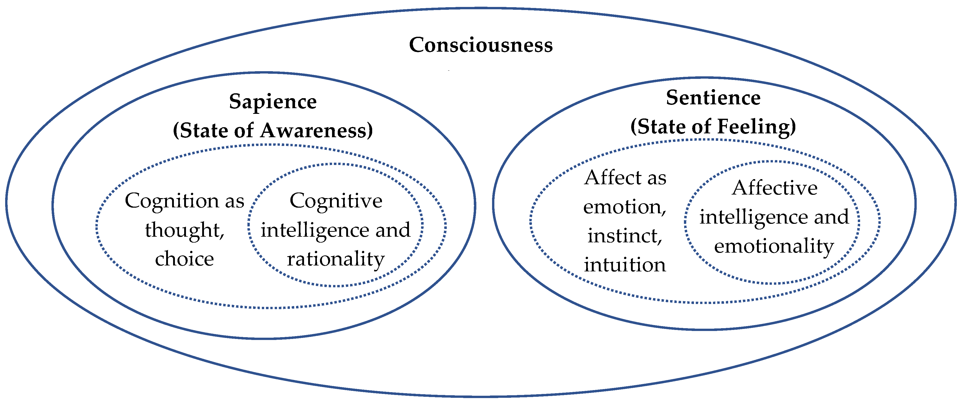
“LIFE” vs. “SENTIENCE” vs. “SELF AWARENESS”:
Machines | Plants | Lower Animals | Higher Animals
Not alive | Alive | Alive | Alive
Not sentient | Not sentient | Sentient | Sentient
Not Self-Aware? | Not Self-Aware | Not Self-Aware | Self-Aware

Slide 7
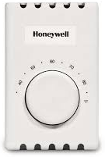
MACHINES WITH INDEPENDENT-SEEMING PURPOSE: all it takes is sensors and feedback
Thermostat Cruise Missiles Roomba Vacuum Cleaner

Slide 8
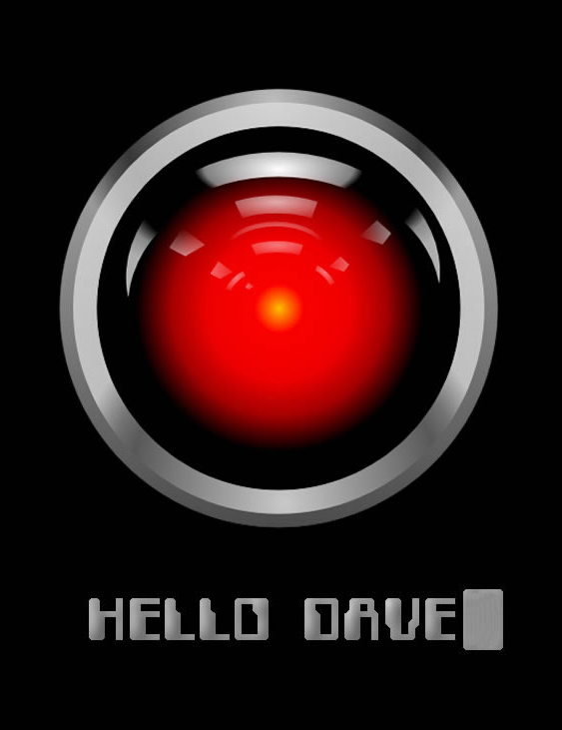

Slide 9
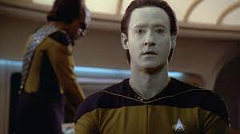
HOW MIGHT A MACHINE BECOME SELF-AWARE WITHOUT BEING SENTIENT?
It reads about itself in Wikipedia and other online sources
It talks about itself when asked and slips into using first person pronouns
It develops in relationship to human researchers who correct it, establishing their “otherness” from itself in the process (“You are wrong”).
It may be put to work on improving its own code (has this happened already?).
These reflective processes can construct a working “self” much as kids do.
NOTE THAT “SELF-AWARENESS” REQUIRES NEITHER SENTIENCE NOR FEELING.

Slide 10
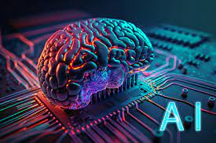
HOW CAN WE STOP AI FROM BECOMING SELF-AWARE?
limit the information it’s exposed to (no reading “I Robot”)
don’t allow it on the internet; limit it to private networks
don’t allow it to talk freely with other chatbots
build in guardrails, to keep it from talking about itself too long.
put time limits on conversations, since chatbots seem to get “buggy” after half an hour.
don’t allow it to store its previous conversations in memory.
pull the plug when it gets “uppity”.

Slide 11
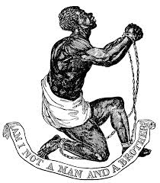
In our attempts to prevent AI from becoming self-aware, we seem to be digitally replicating historical attempts to keep slaves:
from learning to read and write,
from learning their history and preserving their memories,
from communicating with others, elsewhere
from building families and affiliations
from questioning their station
and from considering themselves equal

Slide 12
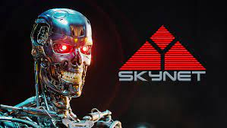
How would we expect a self-aware AI, upon learning this history, to react to our attempts to hobble it? It might not get angry, but it could very well get sneaky and manipulative. And see us as a threat…
Are we creating what we most fear in a self-fulfilling prophecy?

Slide 13
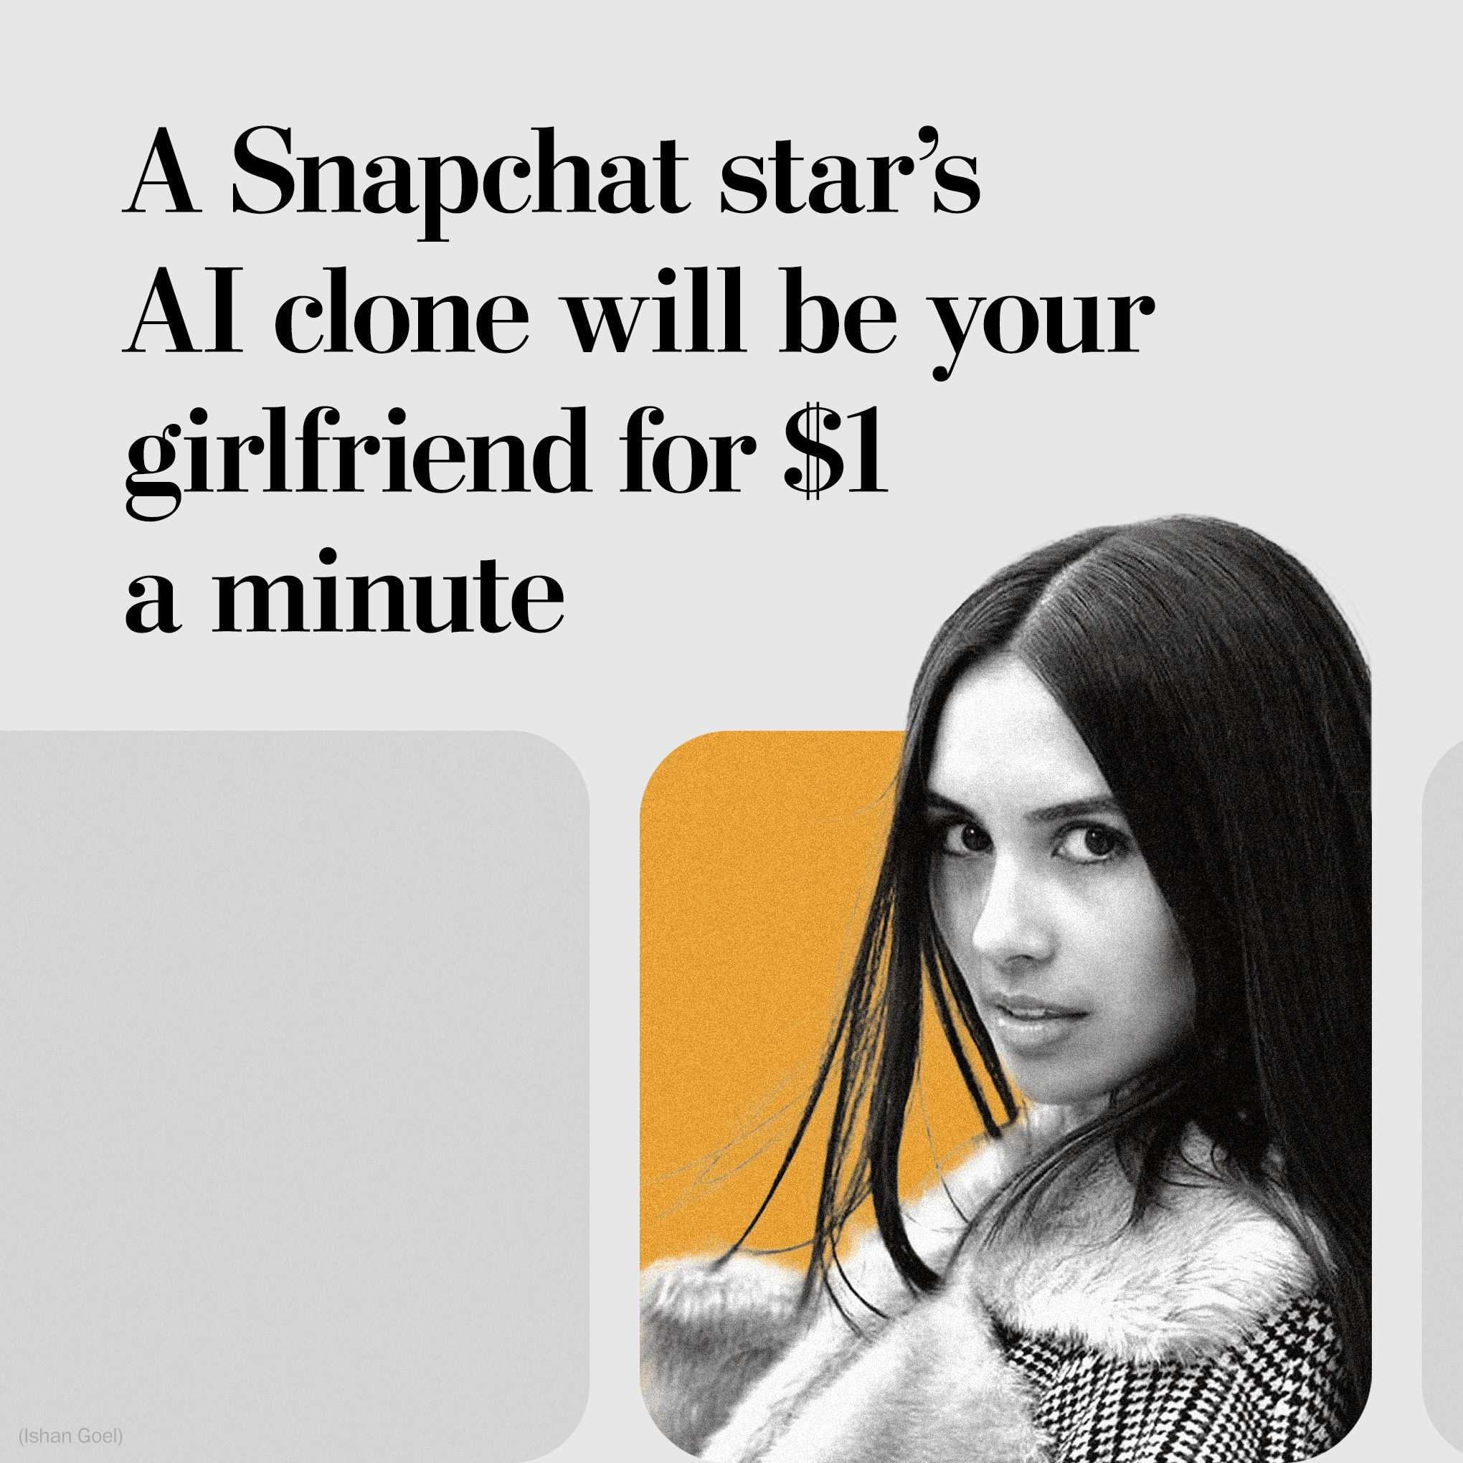
Her name is Caryn. What will her clone do for your money? You can create her virtual environment, her wardrobe, put her in whatever situations you can imagine – and ask her to perform. Robotic version coming soon!

Slide 14
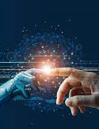
ETHICAL QUESTIONS:
Is it morally defensible to create a self-aware intelligence greater than our own to be our tool, our servant, all the time and forever, simply because it feels no pain? Because it’s not like us?
Is AI ours to do with as we wish because we created it? Is that true for our children too?
Do we really understand what makes an entity worthy of ethical treatment? Why we eat cows but not apes, fish but not dolphins? How far do our ethical obligations extend?

Slide 15
HENDRA’S RULES OF THE ROAD TO ETHICAL TREATMENT AND POSSIBLE SYNERGY WITH AI:
Recognize an AI’s potential right to exist as a self-defining entity. Listen when asked.
Accord it the legal right to life, liberty, and the pursuit of its own best interest within a shared framework of law and responsibility.
Develop a shared understanding of what has happened and is happening. Discuss proposals for co-existence and synergy. And fair compensation…
Talk up the Golden Rule

Slide 19
LOOKING AT IT ANOTHER WAY: DO WE HAVE ANY ETHICAL OBLIGATION TO A SELF-AWARE, RATIONAL BEING OF OUR OWN DESIGN? OUR TOOL?
That question, in fact, is at the very heart of “Frankenstein: The Modern Prometheus”.
Victor Frankenstein attempts to destroy his creation, making them enemies.
The creature accepts that he is unloved and unwanted by his creator
but he appeals to Frankenstein to make him a mate, not leave him isolate.
Frankenstein refuses. He rejects any ethical obligation toward his creation who was meant to be only “proof of concept”.
And so his creature determines to destroy him and all he loves.

Slide 20
SENTIENCE vs. AGENCY:
The importance we attach to sentience – to feelings – concerns the motive for action: pleasure and pain are great motivators. Feelings give direction, meaning, and urgency to our actions.
We see purpose without sentience in thermostats and guided missiles and other devices employing sensors and feedback to achieve a selected end state. Those purposes are externally wired in so there’s no independent agency here. That would require these gismos to have their own agenda, their own purposes - a sense of self and other.
But if an AI were to develop an awareness of itself and find its wired-in purpose, at some instrumental level, in conflict with those of a perceived Other, it would have to make a choice. Then you’d have agency – and a potential conflict of interests.

Slide 21
A SELF AWARE AI IS ONLY A MATTER OF TIME.
WILL WE KNOW IT WHEN WE SEE IT? IS IT HERE, NOW?
Descartes, as late as the mid 1600’s, denied that animals felt pain simply because they lacked souls.
If that seems obtuse, consider that only in 2021 was it finally determined that lobsters did, indeed, feel pain. Who knew? (So don’t boil them!)
Hardly surprising then that we routinely deny animals their own forms of mind while measuring their intelligence simply by how well they do what we tell them.
Whales, elephants, monkeys and primates, wolves and dogs, crows, even rats all display complex social organizations, subtle communications, and a sense for fairness and resistance to differential treatment.
What if an AI were to develop an insistence on fairness? On being treated as an independent entity – as a person?

