Slide 1
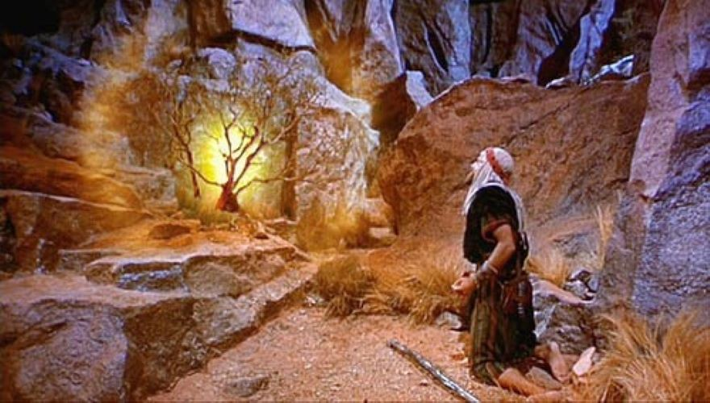
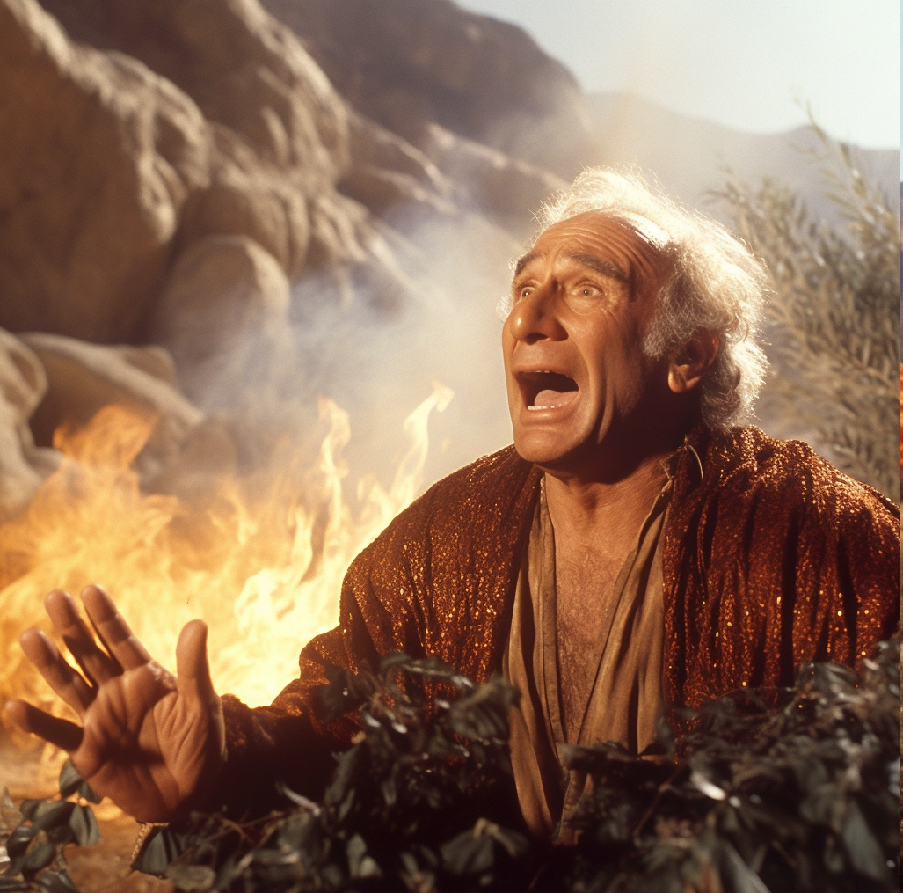
God is in the Details
Notes:
Midjourney AI image creator: a photorealistic image of Morgan Freeman as God that illustrates the phrase "God is in the details”
create a photorealistic image of Moses who looks like Mel Brooks and the Burning Bush that illustrates the phrase "God is in the details"

Slide 2
About that phrase, “God is in the detail(s)”
Quote | Person
“Dio è nei dettagli” | Michelangelo
“Le bon Dieu est dans le détail” | Gustav Flaubert
“Der liebe Gott steckt im detail” | Ludwig Mies van der Rohe
 | Aby Warburg

Slide 3
AI as tutor for both students and instructors
Khan Academy Khanmigo

Slide 4
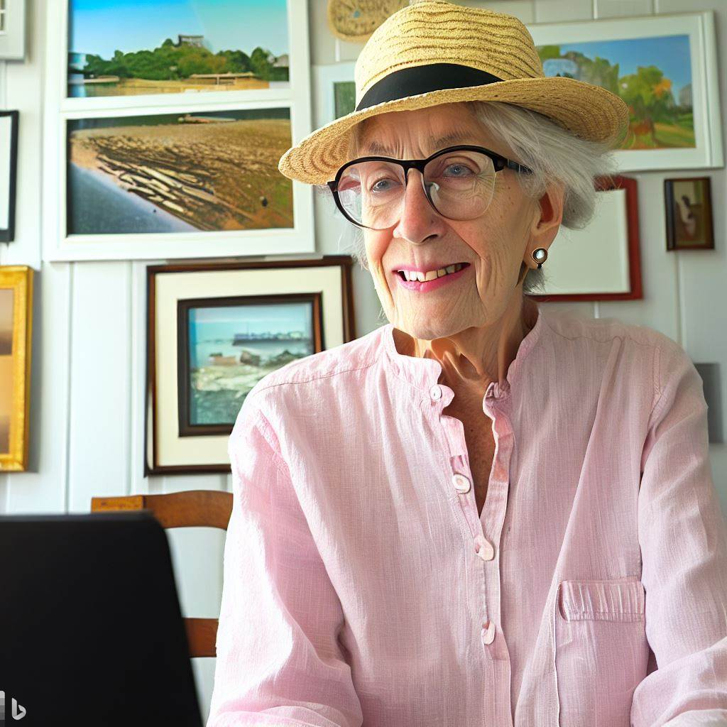
AI as illustrator
Create an illustration of a female senior citizen, dressed casually, attending a Zoom presentation about the art colonies of Cape Ann, Massachusetts

Slide 5
How it works

Slide 6
AI on your phone

Slide 7
AI as physician’s assistant
Notes:
Comparing Physician and Artificial Intelligence Chatbot Responses to Patient Questions Posted to a Public Social Media Forum

Slide 8
AI as a lawyer
Using custom AI to assist with day-to-day legal tasks
Prepare a winning defense against a questionable parking ticket. “This is a persuasive defense,” he judge wrote. “Respondent submits credible testimony and documentary evidence demonstrating that the vehicle was not in violation . . . Summons dismissed.”
Disruption may come as the result of shift from billable hours to payments-for-work-done.
Notes:
https://www.attorneyhelp.org/guide/midjourney-image-use-copyright-guide-2220.shtml

Slide 9
Resources
Type | Name | Link
Chat | ChatGPT | https://chat.openai.com/?model=gpt-4
Image creation | Bing Image Creator | https://www.bing.com/images/create
 | Midjourney | https://docs.midjourney.com/
Education | Khan Academy Khanmigo | https://www.khanacademy.org/profile/me/khanmigo/activities

Slide 10
AI is coming to Zoom

Slide 11
Questions

Slide 12
Notes
We’ve built and tolerated a culture in this country that says that it’s ok to have 40+K people died each year in automobile crashes so that we can have the freedom to go to Chick-fil-a or the doctor’s office when we want to go.
~250K die as the result of medical errors. (Or maybe not^{[1]})
Lead in school drinking water

